Slide 1
Behavior Reduction: Behavior Reduction Plans and Functions of behavior
2
+
2
+
Thomas J Bardin, M.S., BCBA

Slide 2
Why do they do that? Behavior Reduction plans and Functions of Behavior
40 Hour RBT Course

Slide 3
Objective
D-1 Identify essential components of a written behavior reduction plan

Slide 4
Behavior Reduction Plans
Operational definitions of target behaviors
Antecedent modifications
Replacement behaviors
Consequence modifications
Persons responsible
Emergency measures
Function of behavior

Slide 5
Thus…
A Behavior Reduction plan requires a Functional Behavior Assessment or FBA
So what functions are there to look for? We’ll get there in a moment, but first…
Notes:
And we will practice identifying the common components of behavior reduction plans in the next few slides as we look at a Behavior Support Plan (BSP) template and a Behavior Intervention Plan or BIP

Slide 6
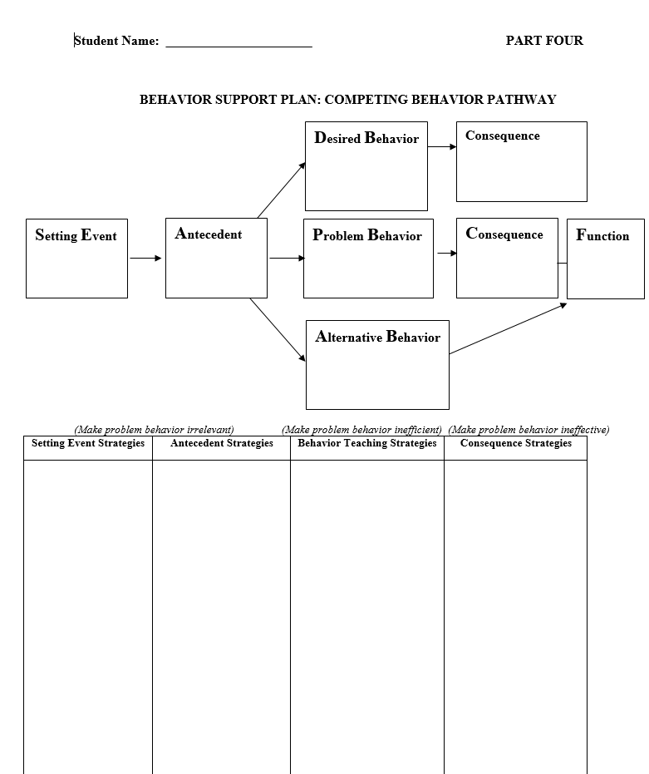
Notes:
An example of a Behavior Support Plan. Often found in residential settings as well as clinic and home based therapy.

Slide 7
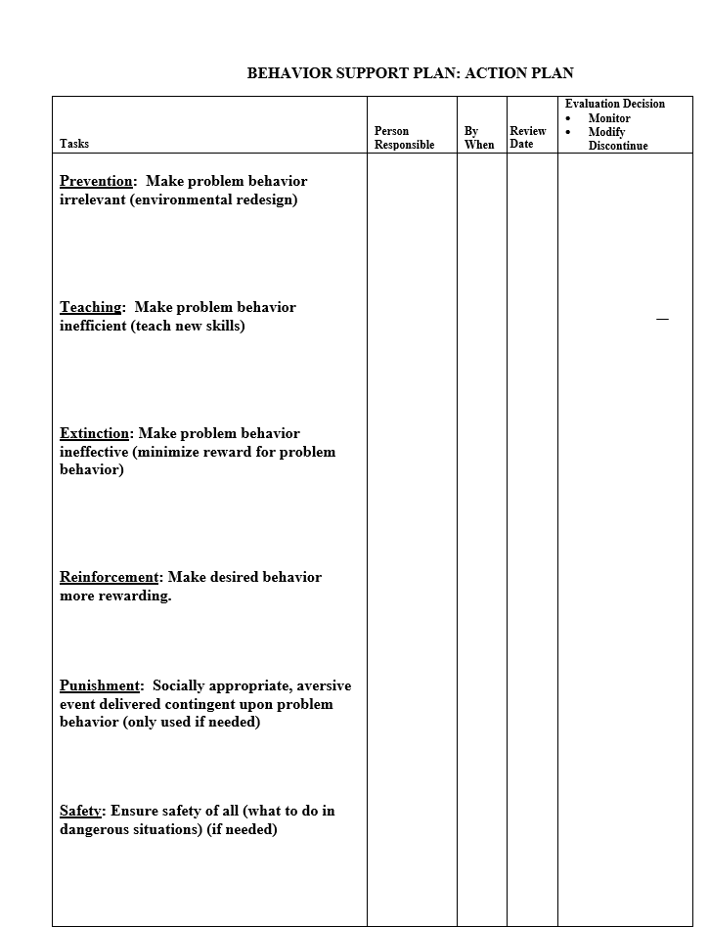
Notes:
Prevention is antecedent strategies that will be used to prevent problem behaviors. Teaching is referring to replacement behaviors or new skills such as functional communication. We will be going over extinction in this unit, and if you look down to the safety section, that would be the crisis procedures and this is important to know for any client you work with, because you will not have time to grab the binder and read it when a crisis actually happens.

Slide 9
D-06: Implement crisis/emergency procedures according to protocol
Will differ for each client but you should look for and be familiar with the following:
Emergency contact information
Emergency service numbers (police, fire department, EMS)
Medical information. i.e. Epilepsy is common in the ASD population and you should know how to respond in case of a seizure.
Neglect and abuse reporting: you are most likely a mandated reporter.
How to react to maladaptive behaviors from the client:
Aggression toward you, peers, other adults, all three groups
Elopement
Property Destruction

Slide 10
Four “Whys” functions of behavior
Escape/avoidance
I don’t want to do this
Attention seeking
Look at me look at me!
Access to tangible
I want that!
Automatically reinforcing
This feels good when I do this

Slide 11
Escape/Avoidance
1

Slide 12
Escape/Avoidance (I don’t want to do that)
Food they don’t want to eat
Difficult activities
Things they don’t understand
Things that feel uncomfortable
Overwhelming activities
Notes:
What would you like to escape. At that age? If you had a similar skill set?

Slide 13
Escape/Avoidance (I don’t want to do that)
Examples
Laughing every time someone tries to feed them food they don’t like
Running away when told to make eye contact or say something
Throwing toys when told to clean up
Throwing tantrums when told to get dressed or get ready to leave
Notes:
With this in mind, do you believe timeout is always effective? It’s not and this function of behavior should make that point abundantly clear.

Slide 14
Attention
2

Slide 15
Attention (Look at me look at me)
Laughing loudly or making repetitive noises
Hitting
Tripping over toys or falling down a lot
Crying
Throwing food or toys
Notes:
Attention and number 3, access to tangible, often look very similar and are linked at the hip.

Slide 16
Access to Tangibles
3

Slide 17
Access to tangible (I want that)
Hitting when an activity is terminated
Crying when told to clean up
Crying when a toy or activity is removed
Crying when denied hug or kiss
Crying when told to wait for something
Notes:
Little Freddie is crying to get mom’s attention so that he can gain access to that sweet sweet cookie. Socially mediated access SMA as us Bas call it. FCT commonly used to treat this.

Slide 18
Automatic
4

Slide 19
Automatically reinforcing (This feels good when I do it)
Scratches a spot repetitively
Engages in a behavior when no one is around
Says the same thing over and over
Shakes objects in front of their face
Notes:
Self-pleasure, medical. MM.

Slide 20
ASR
Monique throws an average of two tantrums per/day at school. The tantrums last a total of 34 minutes and usually occur before math or writing assignments. What is the function of Monique’s tantrums?

Slide 21
ASR
Monique throws an average of two tantrums per/day at school. The tantrums last a total of 34 minutes and usually occur before math or writing assignments.
What measurement procedures are used?

Slide 22
ASR
What additional information would you need to make a hypothesis about the function of Monique’s behavior?

Slide 23
References
Behavior Analyst Certification Board. (2014). Applied Behavior Analysis Treatment of Autism Spectrum Disorder: Practice Guidelines for Healthcare Funders and Managers.
Cooper, John O., Heron, Timothy E. Heward, William L.. (2007) Applied behavior analysis / Upper Saddle River, N.J. : Pearson/Merrill-Prentice Hall
Tarbox, J. & Tarbox, C. (2017). Training Manual for Behavior Technicians Working with Individuals with Autism.

