Slide 1
Increasing Communication using an AAC
Training your child to use their talker

Slide 2
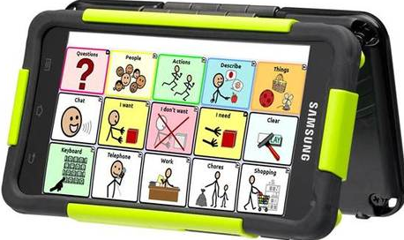
Setting up your child’s device

Slide 3
General guidelines
Keep it handy
Keep it fun
Keep it interesting
Keep it up

Slide 4
General Guidelines (don’t list)
Do not deny your child access to their communication device.
Do not take the communication device away as punishment.
Do not allow games to be played on the device (if it is an iPad or tablet)

Slide 5
What to teach first (to increase the value of the communication device)
Preferred items and activities
Items and activities that you control access to.
Unconditioned Reinforcers (Food, drink) are great requests to begin with.
Eat
Drink

Slide 6
What to teach first (to increase value of communication device)
Teach “jump” instead of “trampoline” to promote language development.
Teach “eat” and “drink” before “pretzels” or “milk”.
As your child becomes fluent using the communication device, you can increase response requirements and teach “eat pretzels” or “drink milk”.

Slide 7
3 Crucial Words to teach
“No”
“Stop”
“Break”

Slide 8
If it’s easier to access preferred items using the communication device, your child will use the communication device.

Slide 9
Increase use of your child’s AAC
Make sure your child’s communication device is:
Easily Accessible
Charged
Make sure you are the only way to access the item you want your child to request.

Slide 10
What to teach first (when the device is valuable)
Approximately 50 words comprise 45%-50% of our daily communication…

Slide 11
Core Words

Slide 12
What to teach next (when the device is valuable)
Core words must be taught for the child to be able to communicate thoughts, feelings, and spontaneous language.
Go
In
Out
Up
Down
On
Off
Core words comprise 80% of communication

Slide 13
Modeling with the communication device
Model using the communication device at a level slightly above the current level of your child.
If you are getting up to go upstairs
“I’m going to go upstairs to bed”
Press the icon for “go” on the communication device.
Modeling the vocal sentence and the corresponding one-word symbol on the device.

Slide 14
What to avoid
Words such as “please” and “thank you” are polite, but not functional.
Avoid overfocusing on sentence structure or word order;
“I go shop banana store” can be shaped to “I am going shopping for bananas at the store”.

Slide 15
Example: “Drink”
To get your attention, your child can select ‘mom’ or ‘dad’
Child selects drink
“What kind of drink?”
Child tells you to “open” juice container
Child selects “cup” for you to pour the juice into.

Slide 16
Common Problems
“My Child asks for the same thing over and over/ My child only asks for things that aren’t available.”

Slide 17
Masking Icons
Most communication devices allow masking of icons.
If an item is not available, mask or hide the icon until the item is available for your child to request.

Slide 18
My child refuses to use the device and _____(insert problem behavior)
Is there motivation for the child to use the device?
If the device gives your child access to preferred items, it will become valuable.
If the communication device is valuable, your child will use it.

Slide 19
General Strategies
Ignore problem behavior and withhold item or activity child is attempting to gain access to.
Prompt child to use their device to make request.
If child uses device, reward immediately with item requested.
If problem behavior persists, do not allow access to desired item.

